Slide 1

TED Talk Performance Predictors
-An application example of
Random Forest
Natural Language Processing
Network Analytics
Negative Binomial Regression
Xiaoyan Zhou
Data Analytics Intern in GwIA

Slide 2
CONTENT
Introduction
Data Description and Analysis
Variable Generation and Evaluation
Model Building and Results
Managerial Recommendations
Limitation and Future Research
TED

Slide 3

1. Intro
Objectives:
Find out the important variables affecting the views of TED Talks
TED Talks producers can better organize their talks
TED.com can improve the demonstration of the talks by optimizing relevant attributions.
Toolkit:
Python Jupyter Notebook/R

Slide 4
1. Intro
Executive Summary:
TED Talk Speakers:
The theme of TED Talks can be adjusted to cater for the flavor of the audiences.
Improve the style of talks and descriptions
TED.com:
Reorganize the recommendation list and expand the list.
Promote TEDx event
Encourage more female TED Talk speaker to join

Slide 5
2. Data Description& Analysis
Columns | Descriptions
comments | The number of comments of the video.
description | A brief introduction of what the talk is about.
duration | The total seconds of the talk.
event | The TED/TEDx event where the talk took place.
film_date | The Unix timestamp of the filming.
languages | The number of languages that the talks is available.
main_speaker | The first name speaker of the talk.
num_speaker | The number of speakers in the talk.
publish_date | The Unix timestamp when the talk was published in TED.com
ratings | Ratings given to the talk, including the name of the ratings (Funny, Beautiful, Obnoxious, etc.) and the count of each sort of rating.
related_talks | Recommended talks to watch next.
speaker_occupation | The occupation of the first name speaker.
tags | The themes associated to the talk.
title | The title of the talk.
urls | The URL of the talk.
views | The number of views on the talk.
2.1 Data Description
Ted_main.csv
Trainscript.csv: transcripts for all talks.
Observation: 2247.
Data source :
https://www.kaggle.com/rounakbanik/ted-talks

Slide 6
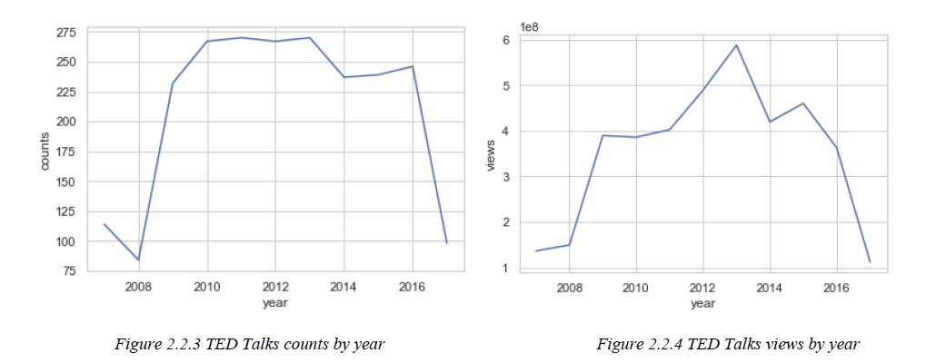
2. Data Description& Analysis
2.2 Data Analysis
(1) The number of TED Talks and views in each year: both surge quickly after year 2008
Before 2009, the number of TED Talks released each year are relatively small, while after 2009, the number of TED Talks released each year are above 225.
TED Talks views increase quickly after the year 2008, peaking in the year 2013, and start to decrease afterward.

Slide 7
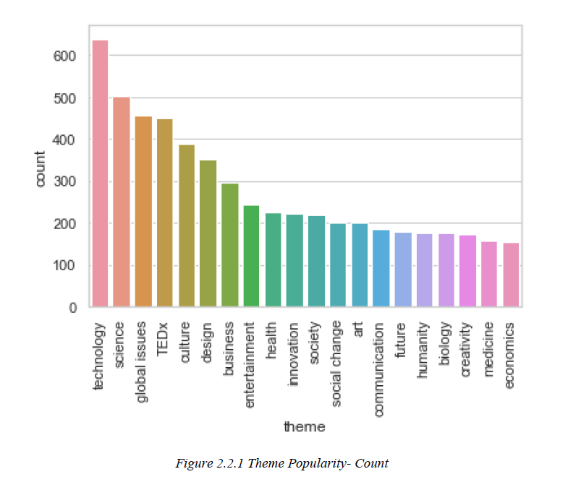
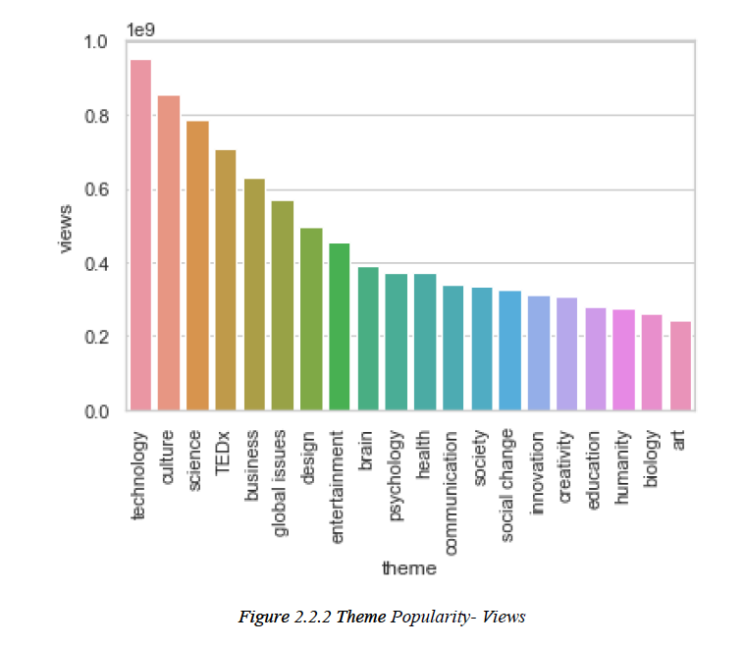
2. Data Description& Analysis
2.2 Data Analysis
(2) Popular themes among TED Talk producer and audience are different
Count:
Future
Medicine
Economics
Views:
Brain
Psychology
Social change

Slide 8
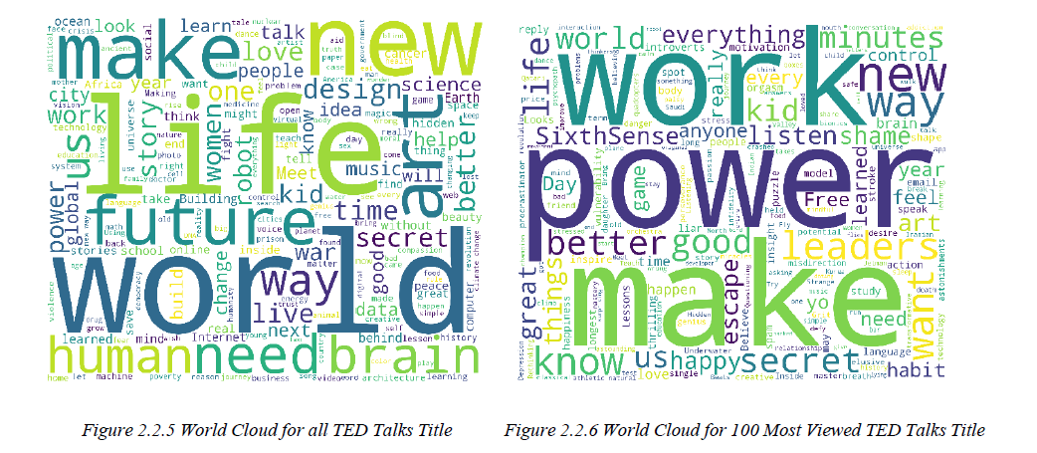
2. Data Description& Analysis
2.2 Data Analysis
(3) Word cloud of title: different aspects of concerns.
All talks:
The TED Talks speakers tend to concern about the influencing the life or the world.
Most views:
More interpersonal, more about improving daily life or work.

Slide 9
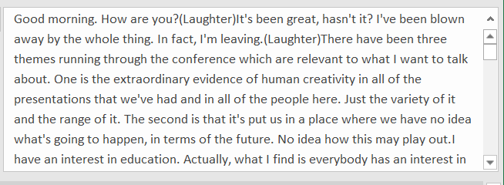
3. Variable Generation& Evaluation
3.1 Variable Generation
Method: NLP(Natural Language Processing)
Data example
Sir Ken Robinson makes an entertaining and profoundly moving case for creating an education system that nurtures (rather than undermines) creativity.
Data Require:
Text data, ie: email, transcript, name, address.
Application:
Style/Theme Analytics
Description Positivity
Python NLTK package
Main Speaker Gender
Python gender_guesser package
Incitement
Ken Robinson
Julia Sweeney
How many times the speaker triggers the audiences to laugh or applause during the talk

Slide 10
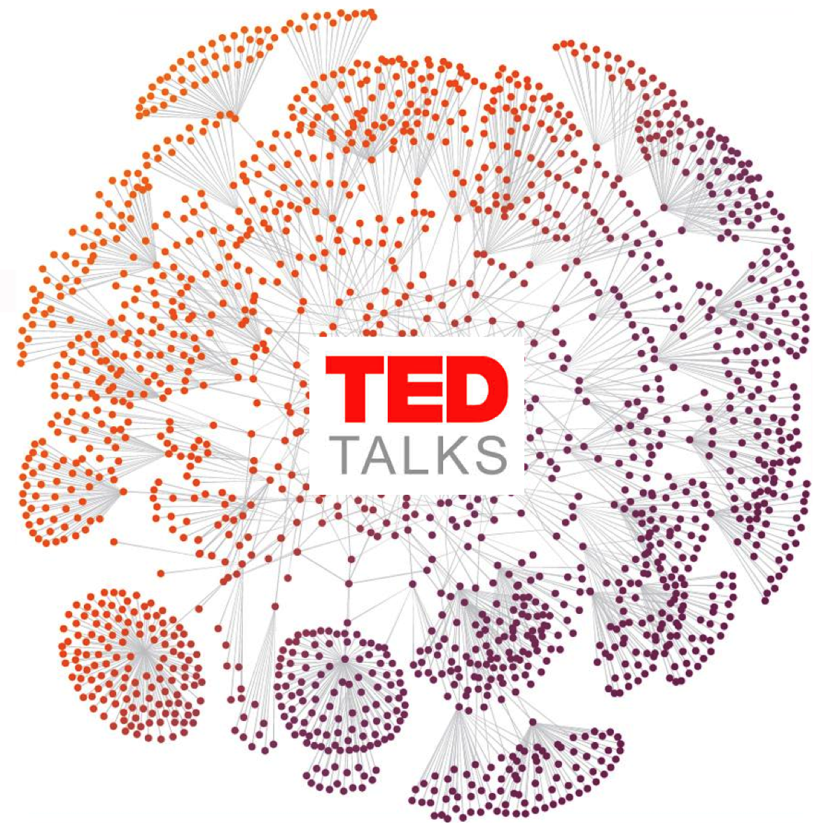
3. Variable Generation& Evaluation
3.1 Variable Generation
Method: Network Analytics
Data required: Data that measures the relationship between objects: social network, communication patterns
Application: Identify influencer in a network; Segmentation/Community detection.
Indegree
How many other talks recommend this talk to play next
Eigenvector Centrality
A TED Talk with high eigenvector centrality means that it is recommended by many other TED Talks who are recommended by many other TED Talks

Slide 11
3. Variable Generation& Evaluation
3.1 Variable Generation
Duration
Year Dummy
TED Global/TED Dummy
20 Themes Dummy

Slide 12
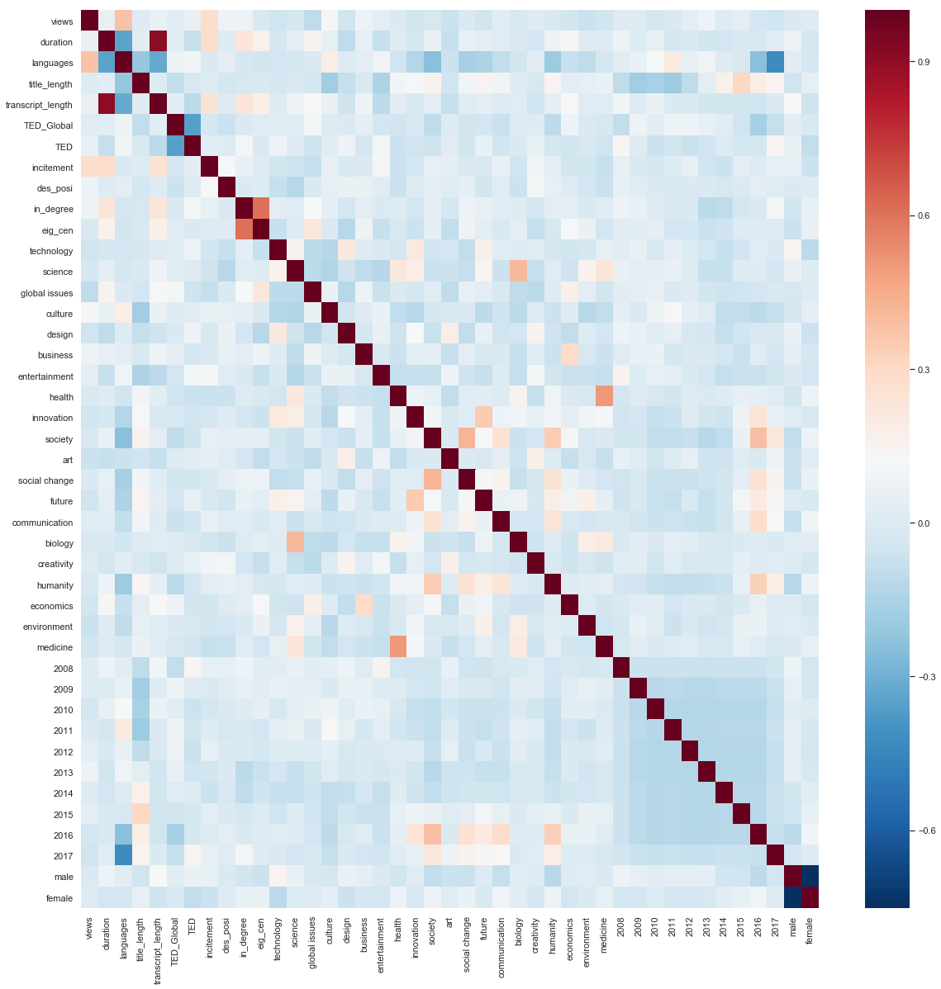
3. Variable Generation& Evaluation
3.1 Variable Evaluation
Step 1: Detecting Sources of Multicollinearity, use correlation heatmap to help selecting variables.
Exclude variable with large VIF values, ie: transcript positiveness, number of speaker, PageRank centrality of TED Talks.
VIF under 10 is acceptable.
Full VIF is in Appendix 1

Slide 13
3. Variable Generation& Evaluation
3.1 Variable Evaluation
Step 2: Feature importance- Random Forest Algorithm (Machine learning methods)
Data required: Targeted factors and relative features that may affect the target
Application: Feature Selection/
Predictive Analytics: Regression& Classification

Slide 14
4. Model Building and Results
Objective:
Find out how the unit change of dependent variables can influence the unit change of independent variables.
Model: Negative Binomial regression
Dependent variable is count data
Heavily right-skewed and over dispersed
Way higher variance (5469585245594) compared to the mean (1722348).

Slide 15
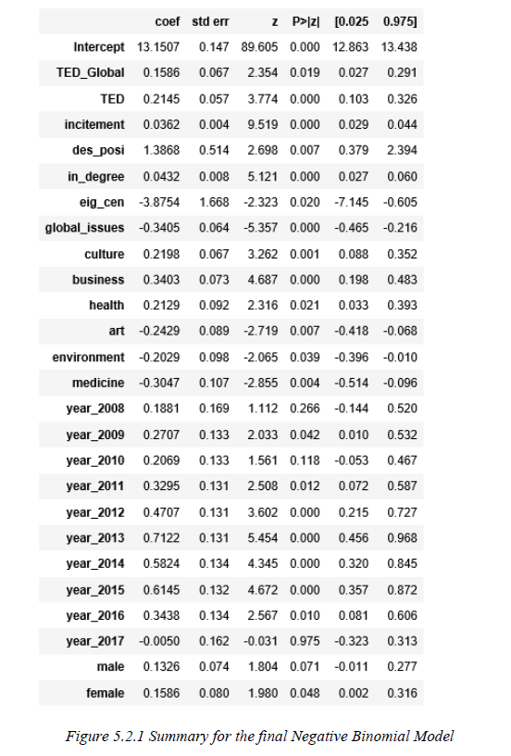

4. Model Building and Results
Results:
What matters:
The event of the TED Talks
Description positiveness
Main speaker gender: female speakers out performance
Theme(Popular: culture, business, and health; Unpopular: global issues, art, environment, and medicine)
Network attributes: Indegree; eigenvector centrality
Year
What doesn’t matter:
Duration
Some other theme: technology, science

Slide 16


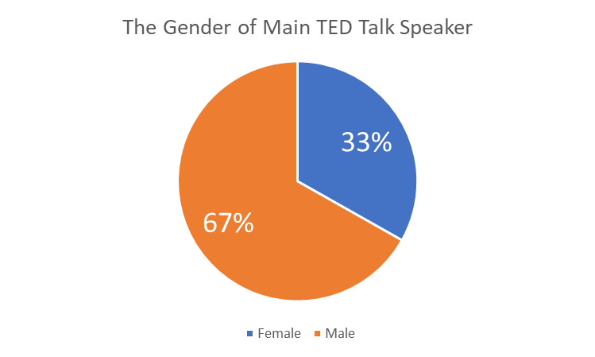
5. Managerial Recommendation
TED Talk Speaker:
Consider the topics that are favored by the audiences or make the talk more relevant to those popular topics.
Articulate the expression, causing more laugh or applause during the speech. Use more positive words to describe the talk.
TED.com:
Encourage and introduce more female speaker to present the talks
Expand the watch next list.
Both the producer and the TED.com can use the negative binomial model trained in this report to predict views for a talk before publishing it
Medicine → Health

Slide 17
6. Limitation and Future Research
Limitations:
Gender variables generated in this report are done by the gender guesser algorithm in Python, not as accurate as collecting the information directly.
The views of TED Talks is considered as a proxy of the TED Talks performances, cannot reflect other aspect of performance – can be improved by using “effectiveness”, “rating positiveness”
Future research:
The eigenvector centrality has a negative influence on the TED Talks views, this result is counterintuitive. Further research is needed to figure out the causal relationship.
(The reason behind this might be that TED.com tend to recommend those unpopular TED Talks after one TED Talk is finished playing.)
K nearest neighboring methods can be used, as this model can match similar TED Talks and predict for the views according to their attributes.

Slide 18

Q&A
Thank you for listening.
Xiaoyan Zhou

Slide 19
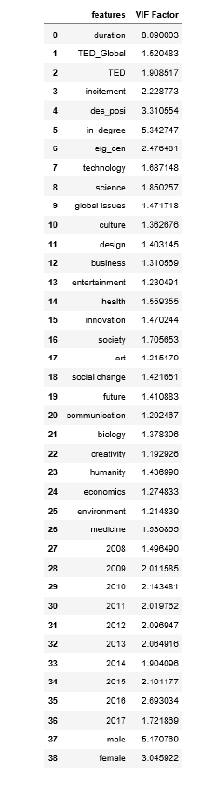
Appendix 1: VIF for Variables Created

Slide 20
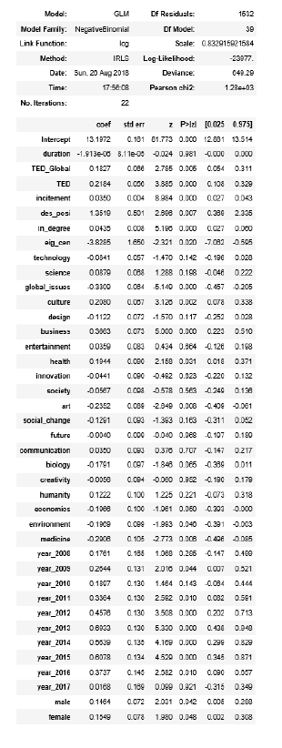
Appendix 2: Summary of the Full Model

